Slide 1
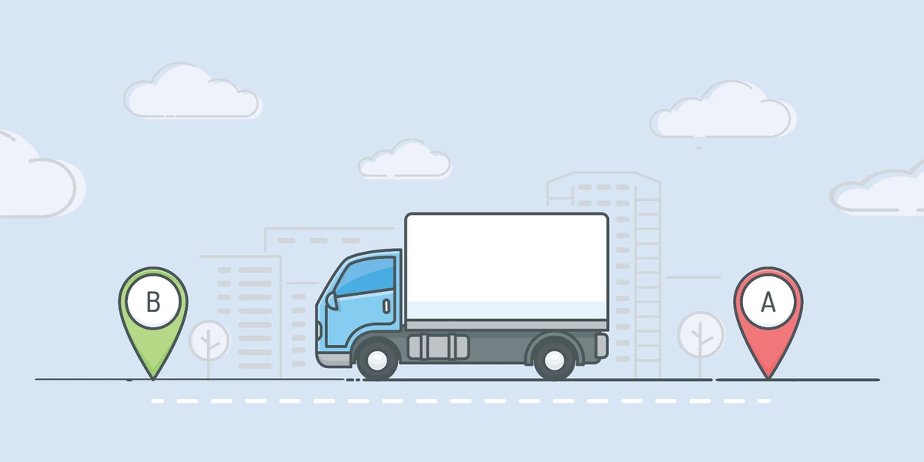
A Study on vehicle routing problem using genetic algorithm with local refinement Presented by - Pranab Kumar Paul

Slide 2
introduction
The Vehicle Routing Problem (VRP) asks the following question: "What is the optimal set of routes for a fleet of vehicles to traverse in order to deliver to a given set of customers?"
Determine a set of routes, S, (one route for each vehicle that must start and finish at its own depot) such that all customers' requirements and operational constraints are satisfied and the total transportation cost is minimized.
The road network can be described using a graph where the arcs are roads and vertices are junctions between them. Arcs may be directed or undirected. Each arc has an associated cost which is generally its length or travel time.

Slide 3
Types of vehicle routing problem
Capacitated Vehicle Routing Problem (CVRP).
Vehicle Routing Problem with Time Windows (VRPTW).
Multi-Depot Vehicle Routing Problem (MDVRP).
Open Vehicle Routing Problem (OVRP) and many more.

Slide 4
Problem instance
vehicle1: Route1: D – 3 – 4 – 5 – D = 14+20+30+12 = 76.
Vehicle2: Route2: D – 2 – 1 – 6 – D = 18+22+28+19 = 87.
Hence total distance covered = 76+87 = 163 (fitness value).
Could be feasible solution.
2
3
22
14
20
18
1
D
4
19
28
12
30
6
5
Our objective is to minimize this cost.
Fig. Road Network

Slide 5
constraints
Capacity: qₒ[4,6,3,2,3,2] i.e., i-th index: customer i and qₒ[i] = customer requirement.
Q: 10 means the vehicle can carry up to maximum 10 units of product.
Constraint: And from now whenever we try to obtain a feasible solution, we need to look if the allocation satisfy the capacity constraints.
Route1 [D – 3 – 4 – 5 – D] total customer requirement is: 3+2+3 = 8.
Route 2 [D – 2 – 1 – 6 – D] total customer requirement is: 4+6+2 = 12 > 10 (invalid).
Hence the overall solution is not feasible now.

Slide 6
Motivation behind ga
In, Mathematical terms VRP can be classified as a NP-Hard Problem, meaning that the required solution time increases exorbitantly with size.
The total time taken to solve the VRP for different numbers of nodes using this brute-force approach is given in Table [1] below.
Problem Size | Solution Time
10 | 3ms
20 | 77 years
25 | 490 million years
35 | 8.4 * 10^15 years
50 | 9.6 * 10^47 years

Slide 7
Motivation behind ga
Due to the difficulty of solving to optimality large-scale instances of vehicle routing problems, a significant research effort has been dedicated to metaheuristics such as Genetic algorithms(GA), Tabu search(TA), Simulated annealing(SA).
These metaheuristics helps the problem solution to converge faster and reach an optimal or near optimal solution in much less amount of time than the brute force methods.

Slide 8
Idea behind genetic algorithm
Based on Darwin’s Principle of Natural Selection.
Darwin’s principle of Natural Selection is stated as “Survival of the fittest”.
Genetic algorithms use techniques inspired by evolutionary biology such as mutation, selection, crossover and inheritance.
The evolution process stops when some predefined termination condition is satisfied. At each intermediate stage, the old generation is replaced by the new generation.

Slide 9
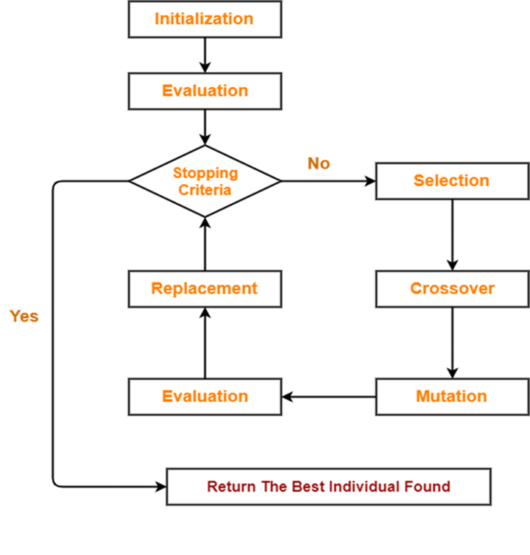
The algorithm
Procedure GA [4]:
Step 1. Initialize the population: current population & Evaluate.
Step 2. Repeat step 3 through step 5 till termination condition is satisfied.
Step 3. Apply selection to obtain the mating pool.
Step 4. Crossover and Mutate the mating pool to generate
The new population.
Step 5. Propagate the current population by the new population.
Step 6. Return the best solution of the current population.

Slide 10
Proposed GA with local refinement
Start
.
Random initialization of Chromosomes encoding potential solutions. Apply linear sweep algorithm to generate a better chromosome
Evaluation
Best fitness saturated for 100 gens?
NO
Selection
Apply genetic operators like selection, crossover, mutation to create child population
YES
Return the best chromosome as solution
Propagate elite chromosomes to the next generation
Apply Local Refinement
End

Slide 11
Chromosome encoding
Route 1
Route 2
Route 3
One of the valid chromosome encoding will be : 1 – 2 – 3 – 4 – 1 – 5 – 6 – 7 – 1 – 8 – 9 – 10.
Here digit 1 represents the depots.
Invalid chromosomes:
Two ones occur simultaneously i.e., 1 – 2 – 3 – 4 – 1 – 1 – 5 – 6.
First digit is not one i.e., 2 – 3 – 1 – 4 – 1 – 5 – 6.
Last digit is one i.e., 1 – 2 – 3 – 4 – 1 – 5 – 6 – 7 – 1.
The above cases can occur simultaneously also.

Slide 12
Population initialization
Initial population is created randomly.
If any chromosome is found invalid we make that chromosome valid using some user defined functions.
Linear Sweep Algorithm [2] is used to generate a fitter chromosome.

Slide 13
Genetic operators: selection
Binary Tournament Selection.
Selection based on fitness value of the chromosome.
Fitness: 250
1 | 2 | 3 | 1 | 4 | 5 | 6
Better Chromosome
1 | 2 | 3 | 1 | 4 | 5 | 6
Fitness: 270
Mating Pool
1 | 4 | 5 | 1 | 2 | 3 | 6

Slide 14
crossover
Parent 1
Offspring 1
1 | 2 | 3 | 1 | 4 | 5 | 6
1 |  |  |  | 1
Crossover
Parent 2
Offspring 2
1 | 4 | 5 | 1 | 2 | 3 | 6
1 |  |  |  |  | 1

Slide 15
Crossover
Parent 1
Offspring 1
1 | 2 | 3 | 1 | 4 | 5 | 6
1 | 4 | 5 | 2 | 1
Crossover
Parent 2
Offspring 2
1 | 4 | 5 | 1 | 2 | 3 | 6
1 | 2 | 3 | 4 |  | 1

Slide 16
crossover
Parent 1
Offspring 1
1 | 2 | 3 | 1 | 4 | 5 | 6
1 | 4 | 5 | 2 | 1 | 3 | 6
Crossover
Parent 2
Offspring 2
1 | 4 | 5 | 1 | 2 | 3 | 6
1 | 2 | 3 | 4 | 5 | 1 | 6

Slide 17
Mutation
Randomly selecting any two cities (except one) and swap them.
Mutation
1 | 2 | 3 | 1 | 4 | 5 | 6
1 | 5 | 3 | 1 | 4 | 2 | 6

Slide 18
Local refinement
Apply TSP
Apply TSP
1 | 2 | 3 | 4 | 5 | 1 | 6 | 7 | 8 | 9
Local Refinement
1 | 3 | 4 | 2 | 5 | 1 | 8 | 6 | 7 | 9
Optimized Offspring

Slide 19
Elitism
prevent the loss of high-quality solutions.
Combine Current Population and Mating Pool, Choose the best α solutions to propagate in next generations.
guarantees the retention of the best chromosome obtained thus far.

Slide 20
Terminating condition
Genetic operators are repeated over multiple generations.
This loop continues until the best fitness value remains unchanged for the last 100 generations.
Return the best chromosome among the current population.

Slide 21
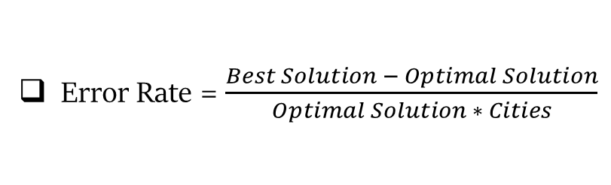
Results
The above-mentioned solution of the VRP is implemented using MATLAB programming language in MATLAB 2021a with the system configuration: Intel(R) Pentium(R) CPU G4400 @ 3.30GHz, 3300 MHz, 2 Core(s), 2 Logical Processor(s), Windows 10 Operating System and 4 GB RAM.
The input instances are taken from the standard VRP libraries: (Augerat, 1995) (Christofides and Eilon, 1969) (Christofides and Eilon, 1969) [3].
The optimal solutions are also given in the above aforementioned libraries.
The Crossover Probability is in range [0.8 – 0.9].
The Mutation Probability is in range [0.1 – 0.3].
The population size is in range [1000 – 5000].
Error Rate = $\frac{Best Solution − Optimal Solution}{Optimal Solution ∗ Cities}$

Slide 22
Results
Instances | Mean Solution* | Mean Solution | Optimal Solution | Error(%)
E-n13-k4 | 247 | 247 | 247 | 0
P-n16-k8 | 450 | 450 | 450 | 0
P-n20-k2 | 218.24 | 218 | 218 | 0
E-n23-k3 | 538.23 | 534 | 534 | 0
A-n30-k3 | 582.47 | 562.87 | 534 | 0.18
A-n32-k5 | 855.12 | 833.34 | 784 | 0.19
A-n38-k5 | 812.36 | 794.49 | 730 | 0.23
A-n45-k6 | 1113.68 | 1056.67 | 944 | 0.26
E-n51-k5 | 696.62 | 652.72 | 521 | 0.49
A-n61-k9 | 1512.23 | 1423.47 | 1034 | 0.61
A-n80-k10 | 2912.45 | 2753.34 | 1763 | 0.70
* Solution without local refinement.

Slide 23
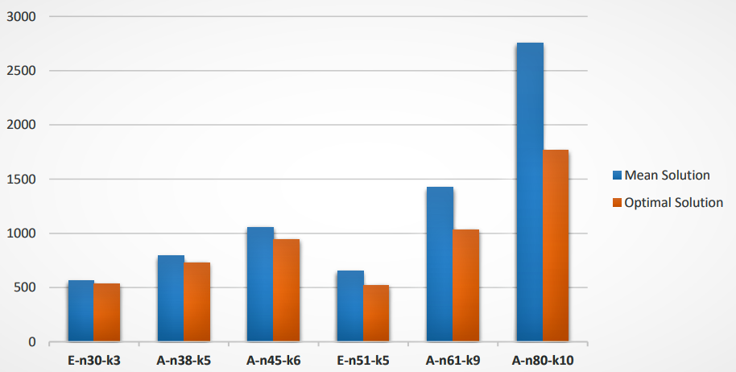
discussion
Figure : Bar chart for showing performance Comparison for the obtained solutions.
X-axis: Problem instance Y-axis: Total distance

Slide 24
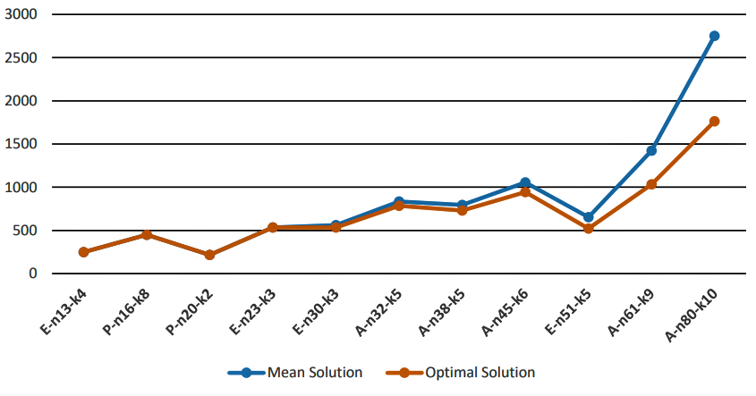
Discussion
Figure : Line chart for showing difference in the result with increasing the size of the problem.
X-axis: Problem instance Y-axis: Total distance

Slide 25
Conclusion
In this article, we have introduced a genetic algorithm (GA) approach for addressing the vehicle routing problem (VRP). The GA-based approach we propose incorporates a local refinement strategy at the end of the genetic operators. By incorporating this local refinement strategy, the overall convergence rate of the approach is improved. Our future aim with this study is to develop a more efficient method for solving VRP using GA. Additionally, we seek to minimize the error rate for larger city instances.

Slide 26
acknowledgement
I want to sincerely thank my supervisor Prof. Priya Ranjan Sinha Mahapatra Professor, Department of Computer Science, University of Kalyani and Dr. Soumen Atta Assistant Professor, Centre for Information Technologies and Applied Mathematics, School of Engineering and Management, University of Nova Gorica for encouraging me and helping me out at each and every step of this work. Again, I want to thank them to permit me in Research LAB, KU for supporting this project.

Slide 27
references
[1] Vehicle Routing Problems 101. by Anand Seshadri | by Opex Analytics | The Opex Analytical Blog | Medium
[2] Kumar, VV Senthil, and R. Jayachitra. ”Linear sweep algorithm for vehicle routing problem with simultaneous pickup and delivery between two depots with several nodes.” Global Journal of Pure and Applied Mathematics 12.1 (2016): 897-908.
[3] CVRPLIB - All Instances (puc-rio.br).
[4] Introduction to soft computing: neuro-fuzzy and genetic algorithms.

Slide 28


